Slide 1
Privacy Policy Regulation (PPR)
Ankith Gunapal

Slide 2

Problem Statement
CalOPPA & FTC Guidelines are inadequate
Example:
HeLa Cells
Hello Barbie
Google WiFi Sniffing

Slide 3

Inspiration
Guiding Principles
Belmont Principles
Solove’s Taxonomy of Privacy
References
California Online Privacy Protection Act
The EU General Data Protection Regulation

Slide 4
Framework
Privacy Policy Overview
Data
Individual Choice & Access
A/B Testing
Privacy Invasion
Privacy Policy Regulation Rubric
Accountability & Enforcement

Slide 5
Privacy Policy Overview
Scope
Availability
Mobile Application Download
Readability
Privacy Policy Rubric

Slide 6
Data
Data Sharing
Delete data from affiliates & subsidiaries
Data Recession
Easy to delete any data
Data Protection
Measures in case of data breach
Accountable for Non-state sponsored data breach
Data Accessibility
View, Download, Delete
Granular control optional
Data Collection
Physically located in the US
No collecting information on others without consent
Data Analysis
Personally Identifiable Information vs Broader trends

Slide 7

Individual Choice & Access
In case of default opt-in, User needs to be warned. Require Consent before proceeding.

Slide 8
A/B Testing
Your organization’s responsibility to explain A/B testing in simple language and type of testing that can be expected.
Informed Consent
Related to content
How to opt-out
Assessment of Risks and Benefits
Compensation
Need not be monetary
No discrimination
Selection of Subjects
Choose fairly

Slide 9

Privacy Invasion
User must be notified in case of privacy invasion
You are responsible for third-party actions regarding insights
Denial of service or reduced service.
User can choose to remove any information

Slide 10
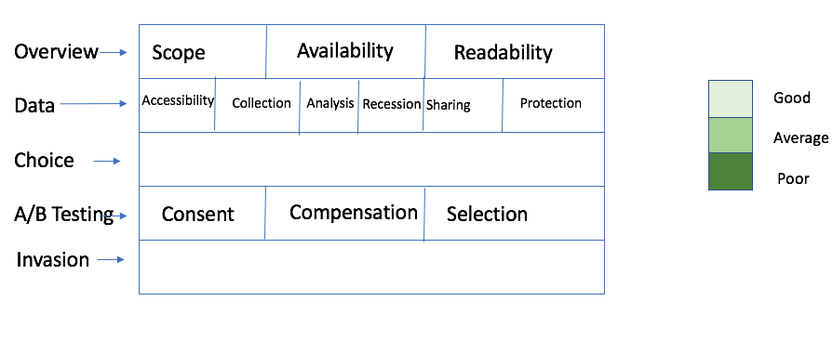
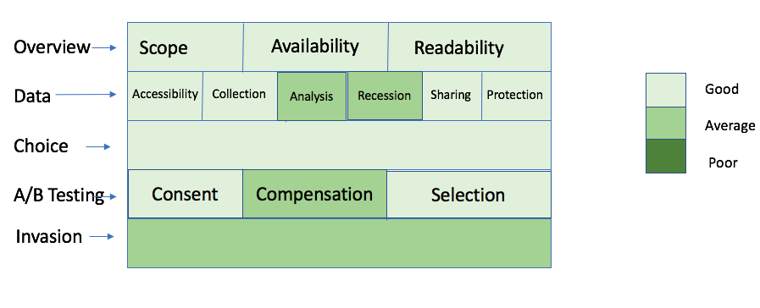
Privacy Policy Regulation Rubric
Example

Slide 11

Accountability & Enforcement
Section 5 of FTC Act
California’s Unfair Competition Law
5 % of global annual revenue – Multi tier

Slide 12
References
EU Data Protection Directive
The Belmont Principles
FTC Guidelines
California Online Privacy Protection Act
The EU General Data Protection Regulation
A/B Testing
FTC Enforcement
California’s Unfair Competition Law Enforcement

